Slide 1
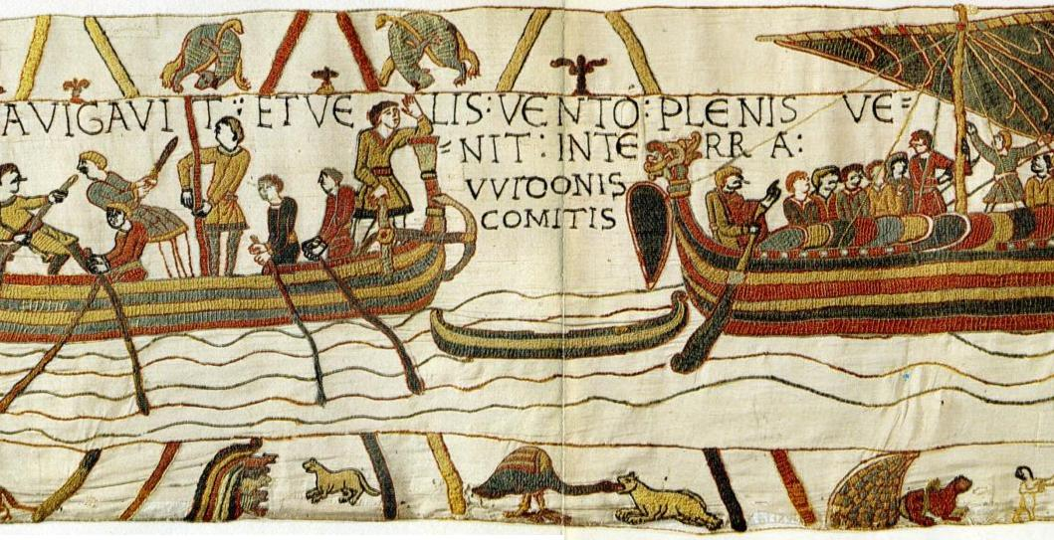
The Battle of Hastings
The Bayeux Tapestry tells the story of the Battle of Hastings.
The tapestry was made around ten years after the battle.

Slide 2
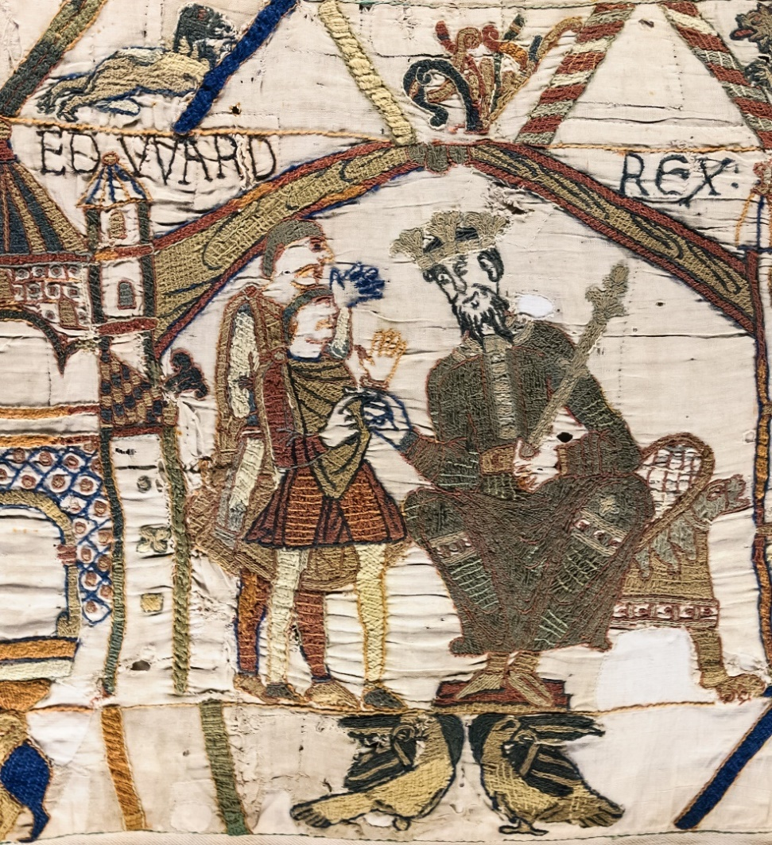
The Passing of the King
In January 1066, the King of England died. His name was Edward the Confessor. The tapestry shows the king handing the crown to his chosen successor – the person he chose to be the next King of England:
Harold Godwinson.

Slide 3
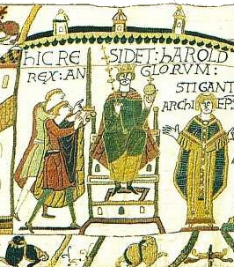
King Harold
Harold was crowned king at Westminster Abbey. The tapestry shows that the congregation are facing Harold, but their eyes are fixed upon Halley’s Comet in the sky overhead, which was seen at the same time, and this was thought to be a bad omen.

Slide 4
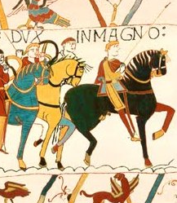
William, Duke of Normandy
William was Duke of Normandy in France. He very much wanted to be King of England and decided on a plan to get his way.
He needed the support of all the nobles and important people. He needed them to agree to his plan to invade England!

Slide 5
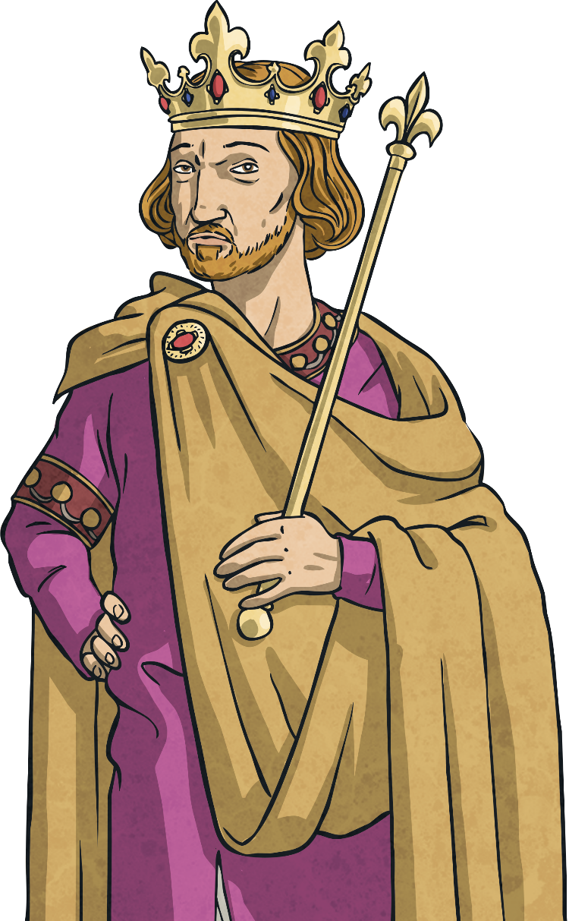
Persuading the Nobles
William had to persuade the nobles to his way of
thinking. To do this, he needed to show them that
it would still be lawful if he was king of England.
He asked the Pope in Rome for his blessing, so that
he could say that God was on his side.
Did you know…? Nobles were people who were landowners, providing work, homes and protection for the peasants who worked for them. Nobles would fight for their king and give them money.

Slide 6
Armies for a Crown
Although the crown would normally pass to the person who had the greatest claim to the throne by birth right, William also knew that the person with the biggest and strongest army would become king. The man who gathered enough support and the biggest army would get the crown.

Slide 7
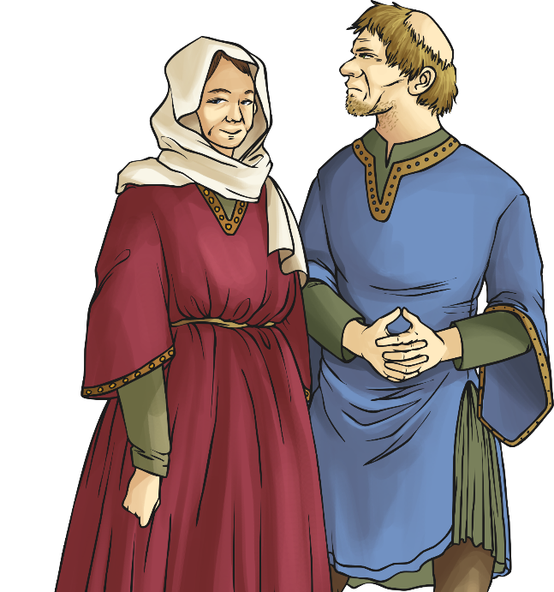
Getting Support
In May, the brother of King Harold, Tostig Godwinson, tried to invade England. Harold called all the peasant farmers to fight for him.
William waited and watched. He wanted to make sure he had enough support before making his move.

Slide 8
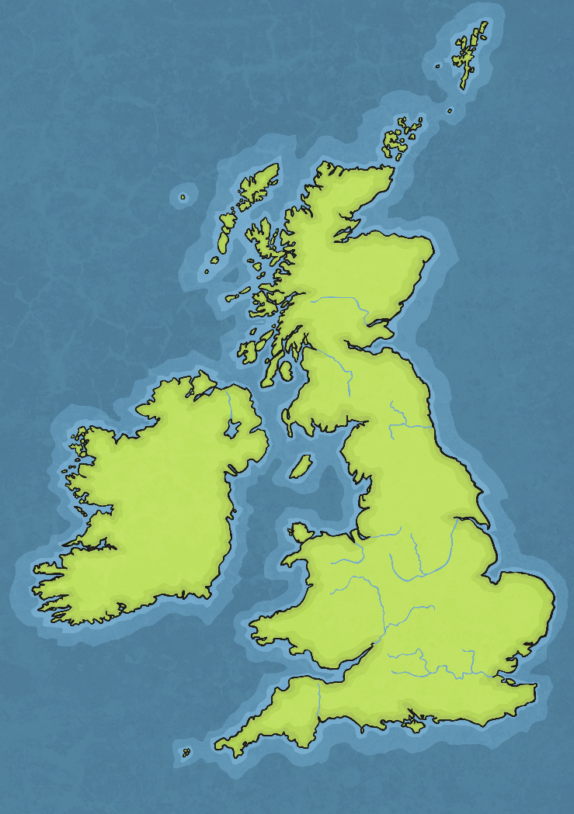
September 1066
Stamford Bridge
Harald Hardrada, the Norwegian king, and Tostig tried to invade Northumbria in the north of England. King Harold sent his army to meet them and the invaders lost the battle at Stamford Bridge in Yorkshire.

Slide 9
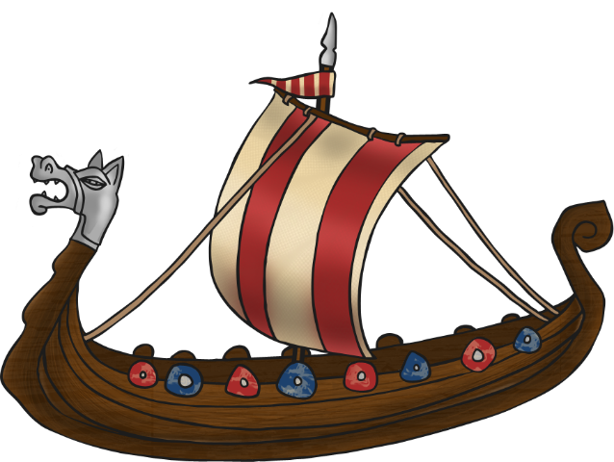
William Makes His Move
Two days later, William and his fleet of 700 ships sailed across the English Channel from France. It is thought he landed at Pevensy because he built a castle there.
The Norman invaders set about pillaging and burning the area across from the harbour mouth in order to force Harold to defend his people and country.
It worked.
Harold raced down the country from York and gathered whatever army he could along the way.
Pillaging means robbing things in a violent, aggressive way.

Slide 10
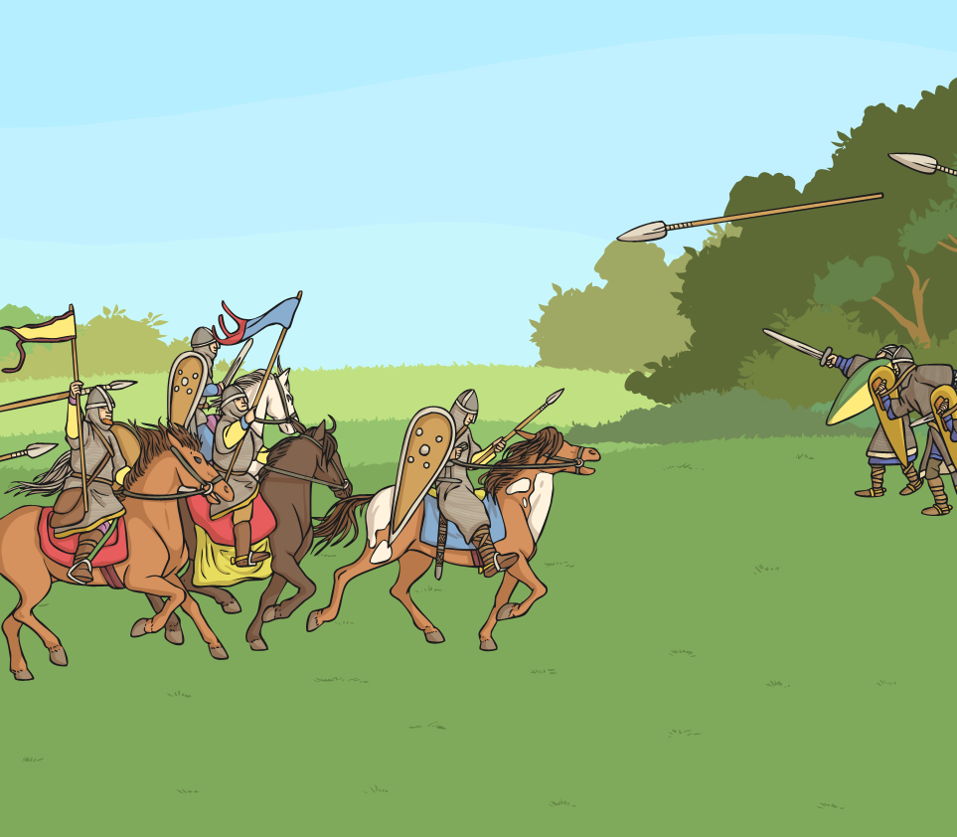
14th October, 1066
Harold was on his way to Hastings.
William heard the news and marched out to face Harold.
The Norman army was made up of 15,000 professional soldiers who were well trained and well equipped.
The English army were tired from their long march. They were poorly paid and many were likely to agree to fight because they were allowed to keep anything they found as a result of battle. They could keep horses,
expensive weapons and armour.

Slide 11
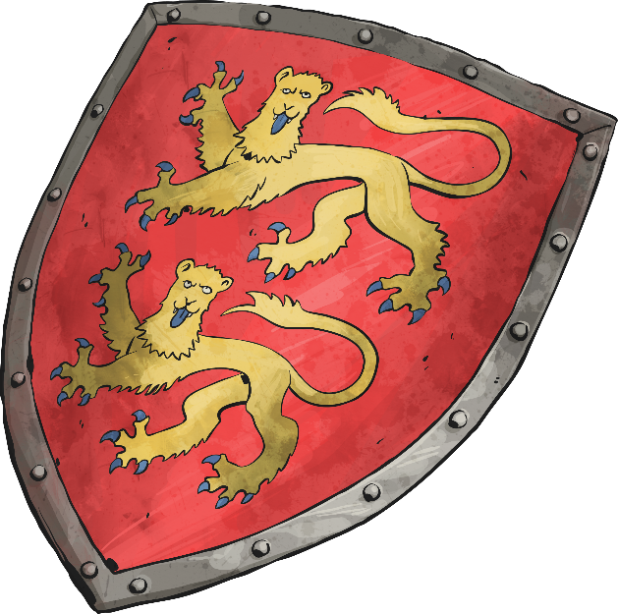
The Battle of Hastings
The Battle of Hastings began. Despite only having 5000 tired, footsore soldiers, Harold’s army put up a very good defence. They were at the top of Senlac Hill and the Normans were at the bottom. The English army formed a shield wall with their shields and it was difficult for the Normans to break through it.
However, word went around that Duke William had been killed. This made the English soldiers drop their shield wall.

Slide 12
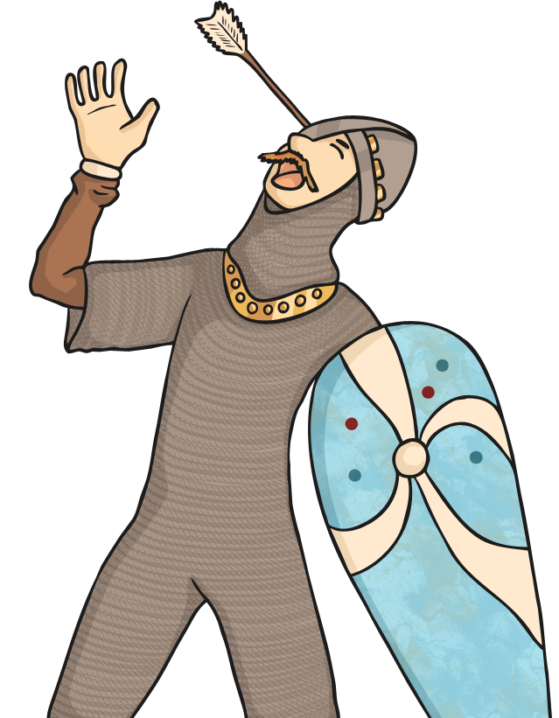
The Duke’s Not Dead!
The story goes that William then took off his helmet and shouted,
“Look at me! I’m alive and with the aid of God I shall gain the victory!”
His army now had more courage and moved in on the English army, mowing them down on their way.
Harold’s two brothers were killed and Harold was shot in the eye with an arrow. Then, he was trampled into the ground. His army ran away into the night.

Slide 13
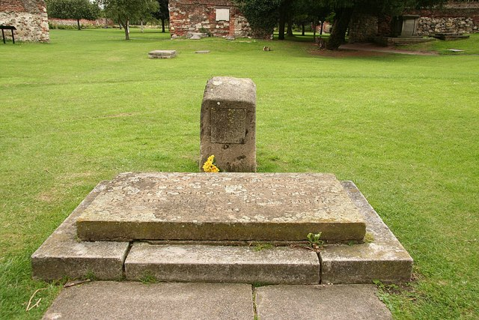
William the Conqueror
William had Harold buried next to the battlefield with a headstone reading ‘Here lies Harold, King of the English’. Harold’s body now rests at Waltham Abbey.
It took two more months for the other
English towns to submit to Norman rule.

Slide 14
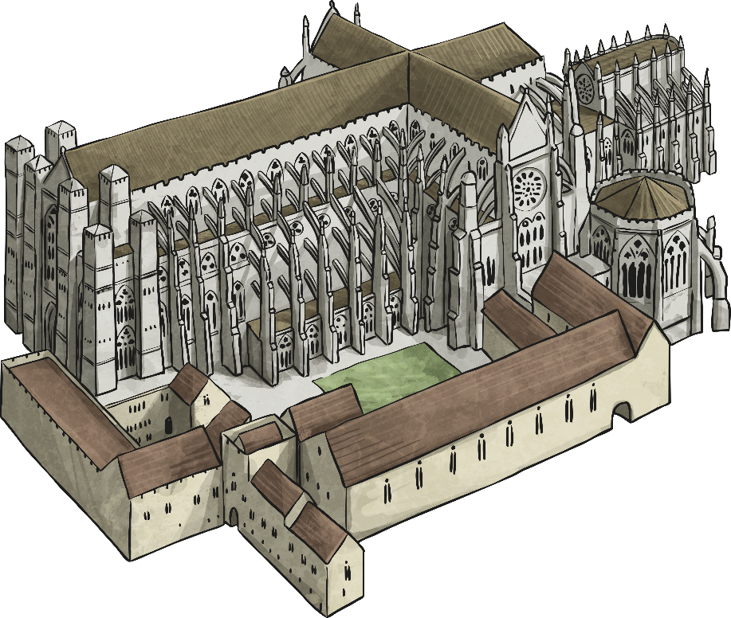
King William
On Christmas Day, 1066, William was crowned King of
England in a ceremony at Westminster Abbey.

